Slide 1
Optimizer

Slide 2
Minimization/ Maximization of Cost Function
Case-1 Perhaps you find yourself running a company, and you've come up with some function to model how much money you can expect to make based on a number of parameters, such as employee salaries, cost of raw materials, etc., and you want to find the right combination of resources that will maximize your revenues.
Case-2 Maybe you are designing a car, hoping to make it more aerodynamic, and you've come up with a function modeling the total wind resistance as a function of many parameters that define the shape of your car, and you want to find the shape that will minimize the total resistance.

Slide 3
Optimizer
In machine learning and artificial intelligence, the way a computer "learns" how to do something is commonly to minimize some "cost function" that the programmer has specified.
Deep learning is a highly iterative process. We have to try out various permutations of the hyperparameters to figure out which combination works best.
Optimizers are algorithms or methods used to change the attributes of your neural network such as weights and learning rate in order to reduce the losses.

Slide 4
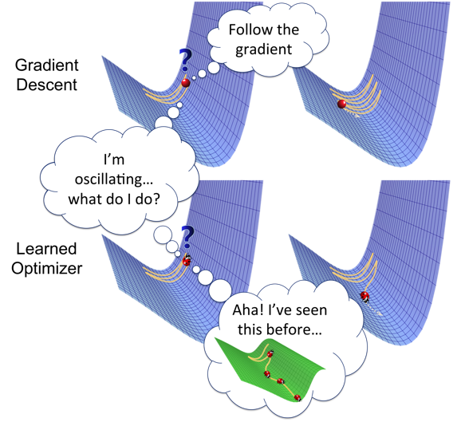
Gradient Descent

Slide 5
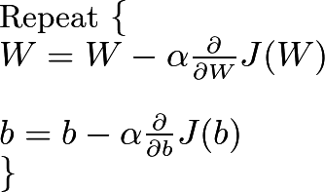
Gradient Descent
The Weight Matrix W is initialized randomly. We use gradient descent to minimize the Cost Function J and obtain the optimal Weight Matrix W and Bias b. Gradient descent is a first-order iterative optimization algorithm for finding the minimum of a function.,
Alpha is learning Rate

Slide 6
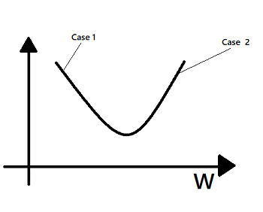
Gradient Descent
Case 1. Let us assume that W was initialized with values less than the values at which it achieves a global minimum. The slope at that point, i.e., the partial derivative of J with respect to W is negative, and hence, the weight value increases according to the Gradient Descent’s equation.
Case 2. Let us assume that W was initialized with values more than the values at which it achieves a global minimum. The slope at that point, i.e., the partial derivative of J with respect to W is positive, and hence, the weight value decreases according to the Gradient Descent’s equation.

Slide 7
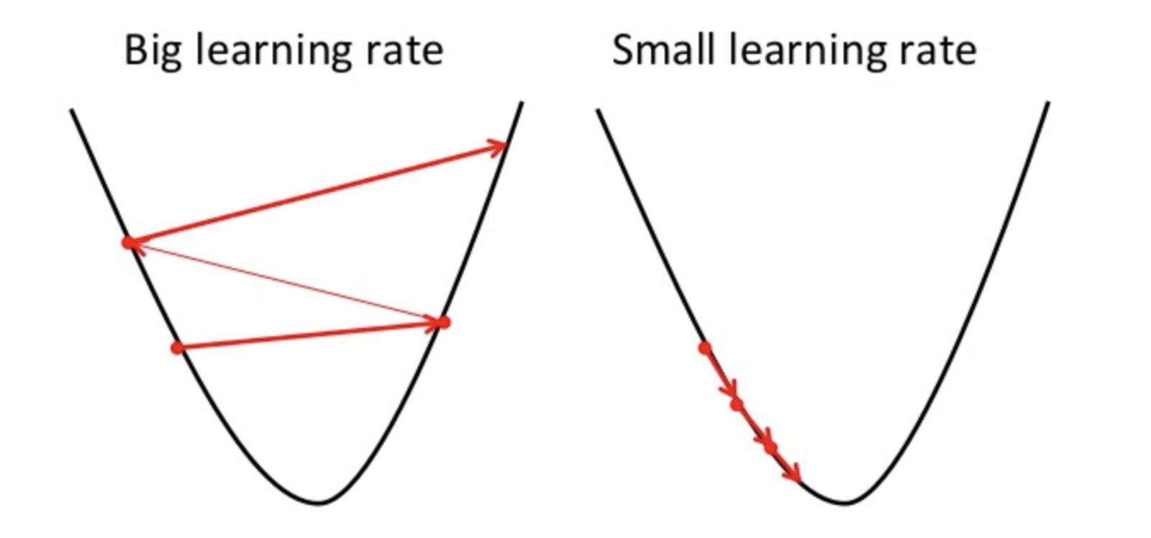
Gradient Descent
Calculate what a small change in each individual weight would do to the loss function (i.e. which direction should the hiker walk in)
Adjust each individual weight based on its gradient (i.e. take a small step in the determined direction)
Keep doing steps #1 and #2 until the loss function gets as low as possible
Cost
Weight

Slide 8
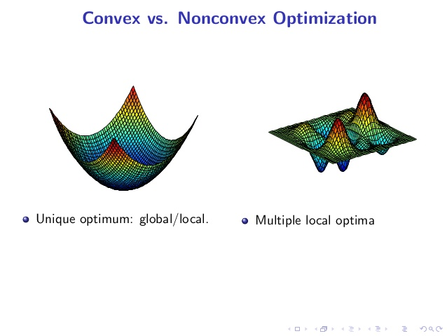
Convex Optimization
Convex optimization involves a function in which there is only one optimum, corresponding to the global optimum (maximum or minimum). There is no concept of local optima for convex optimization problems, making them relatively easy to solve

Slide 9
Non-Convex Optimization
Non-convex optimization involves a function which has multiple optima, only one of which is the global optima. Depending on the loss surface, it can be very difficult to locate the global optima

Slide 10
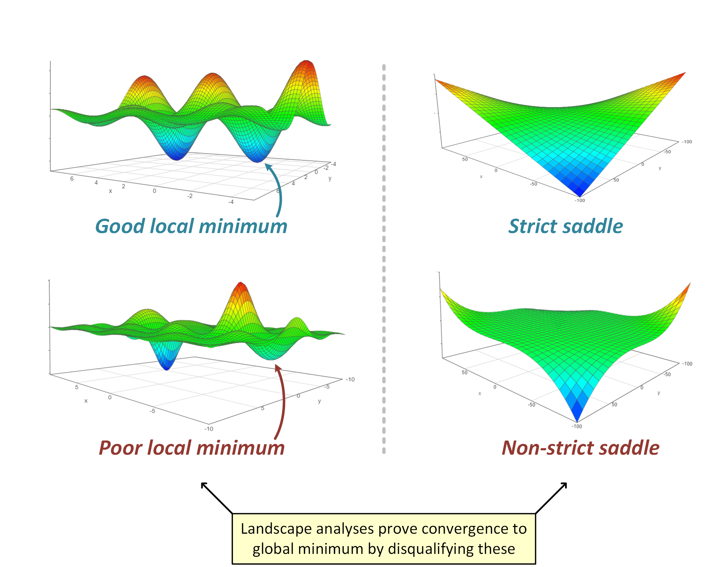
Local Minima, Global Minima and Saddle Point

Slide 11
Stochastic Gradient Descent
Instead of calculating the gradients for all of your training examples on every pass of gradient descent, it’s sometimes more efficient to only use a subset of the training examples each time. Stochastic gradient descent is an implementation that either uses batches of examples at a time or random examples on each pass.
But the problem with SGD is that due to the frequent updates and fluctuations it ultimately complicates the convergence to the exact minimum and will keep overshooting.
Presence of oscillations which result from updates not exploiting curvature information. This results in SGD being slow when there is high curvature.
.

Slide 12
Momentum
Momentum is an added term in the objective function, which is a value between 0 and 1 that increases the size of the steps taken towards the minimum by trying to jump from a local minimum.
Momentum uses past gradients for updating values
If the momentum term is large then the learning rate should be kept smaller.
A large value of momentum to convergence fast. But if both the momentum and learning rate are kept at large values, then you might skip the minimum with a huge step.

Slide 13
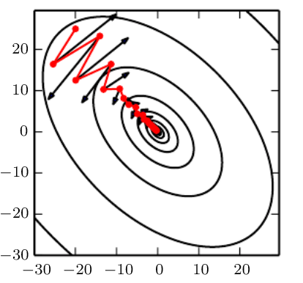
SGD with and without Momentum
SGD without Momentum (Black), SGD with Momentum (Red)

Slide 14
Adagrad
Adagrad adapts the learning rate specifically to individual features:
some of the weights in your dataset will have different learning rates than others.
This works really well for sparse datasets where a lot of input examples are missing.
Adagrad has a major issue though: the adaptive learning rate tends to get really small over time.

Slide 15
RMSprop
RMSprop is a special version of Adagrad developed by Professor Geoffrey Hinton in his neural nets class.
RMS Prop stands for Root-Mean-Square Propagation.
Instead of letting all of the gradients accumulate for momentum, it only accumulates gradients in a fixed window.
RMSprop is similar to Adaprop, which is another optimizer that seeks to solve some of the issues that Adagrad leaves open.

Slide 16
Adam
Adam stands for adaptive moment estimation, and is another way of using past gradients to calculate current gradients.
Adam is a combination of RMSprop and momentum
Adam also utilizes the concept of momentum by adding fractions of previous gradients to the current one.
This optimizer has become pretty widespread, and is practically accepted for use in training neural nets.

Slide 17

Visualization of the Optimization Algorithms

Slide 18
Which optimizer should we use?
If your input data is sparse then methods such as SGD,NAG and momentum are inferior and perform poorly.
For sparse data sets one should use one of the adaptive learning-rate methods.
Adam works well in practice and outperforms other Adaptive techniques.

